Slide 1
Prediction of the destination country for the new user on Airbnb
January, 2023

Slide 2

Why Airbnb?
Trusted online marketplace
150 million users
Notes:
Image 1: https://www.theriver.asia/3-parallax-2/pngkey-com-airbnb-logo-png-605967/
https://www.matthewwoodward.co.uk/work/airbnb-statistics/

Slide 3
The Objective
Discovering factors
User’s first traveling destination

Slide 4











Which Country?
Notes:
Image 2: https://illustoon.com/?id=892
Image 3: https://illustoon.com/?id=896
Image 4: https://illustoon.com/?id=897
Image 5: https://vectorflags.com/united-kingdom/uk-circle-01?ref=trend
Image 6: https://illustoon.com/?dl=899
Image 7: https://illustoon.com/?id=894
Image 8: https://illustoon.com/?id=905
Image 9: https://illustoon.com/?id=903
Image 10: https://illustoon.com/?id=895
Image 11: https://illustoon.com/?id=898

Slide 5
The Benefits
Share more personalized content
Decrease the average amount to booking
Improve forecast demand

Slide 6
The Dataset
The datasets are of type .csv
Airbnb new user competition
The training set:
213 452 records
16 attributes

Slide 7
The Process
01
02
03
04
Preprocessing
Exploration
Modeling
Evaluation

Slide 8
Preprocessing
Having clear dataset from competition
Cleaning and preparation of all files
Vectorizing strings

Slide 9
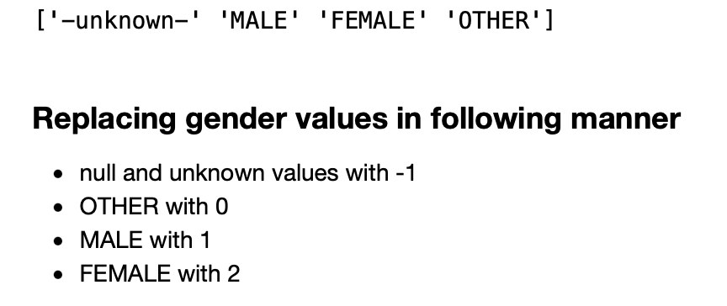
Transforming gender attribute

Slide 10
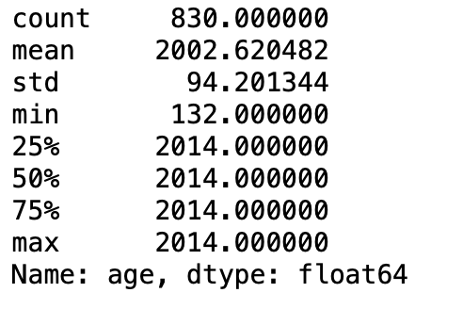
Checking the outliers in age

Slide 11
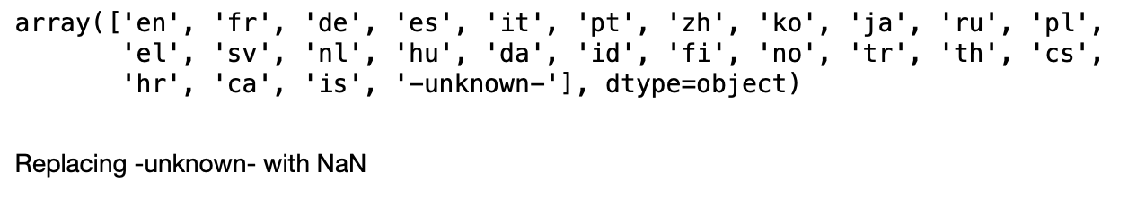
Analyzing language attribute

Slide 12
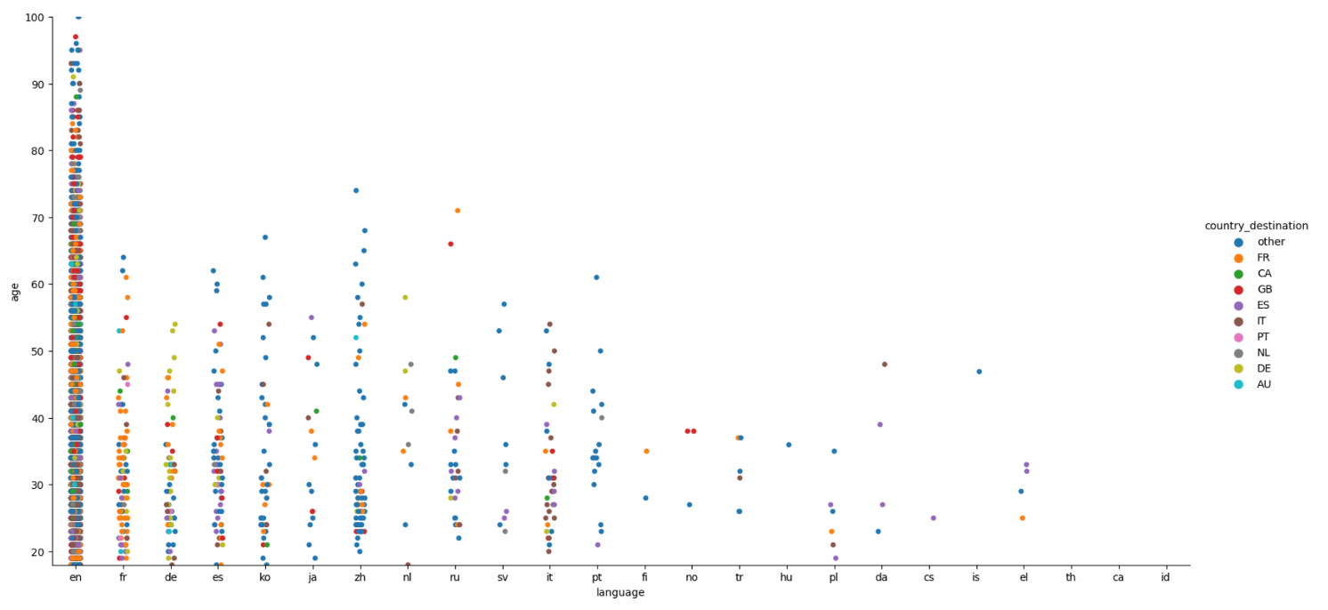
Data exploration

Slide 13
Algorithms and Accuracy Score
0.997
K nearest neighbour
0.876
Decision Tree
0.876
Logistic Regression
0.585
Naive Bayes Classifier

Slide 14
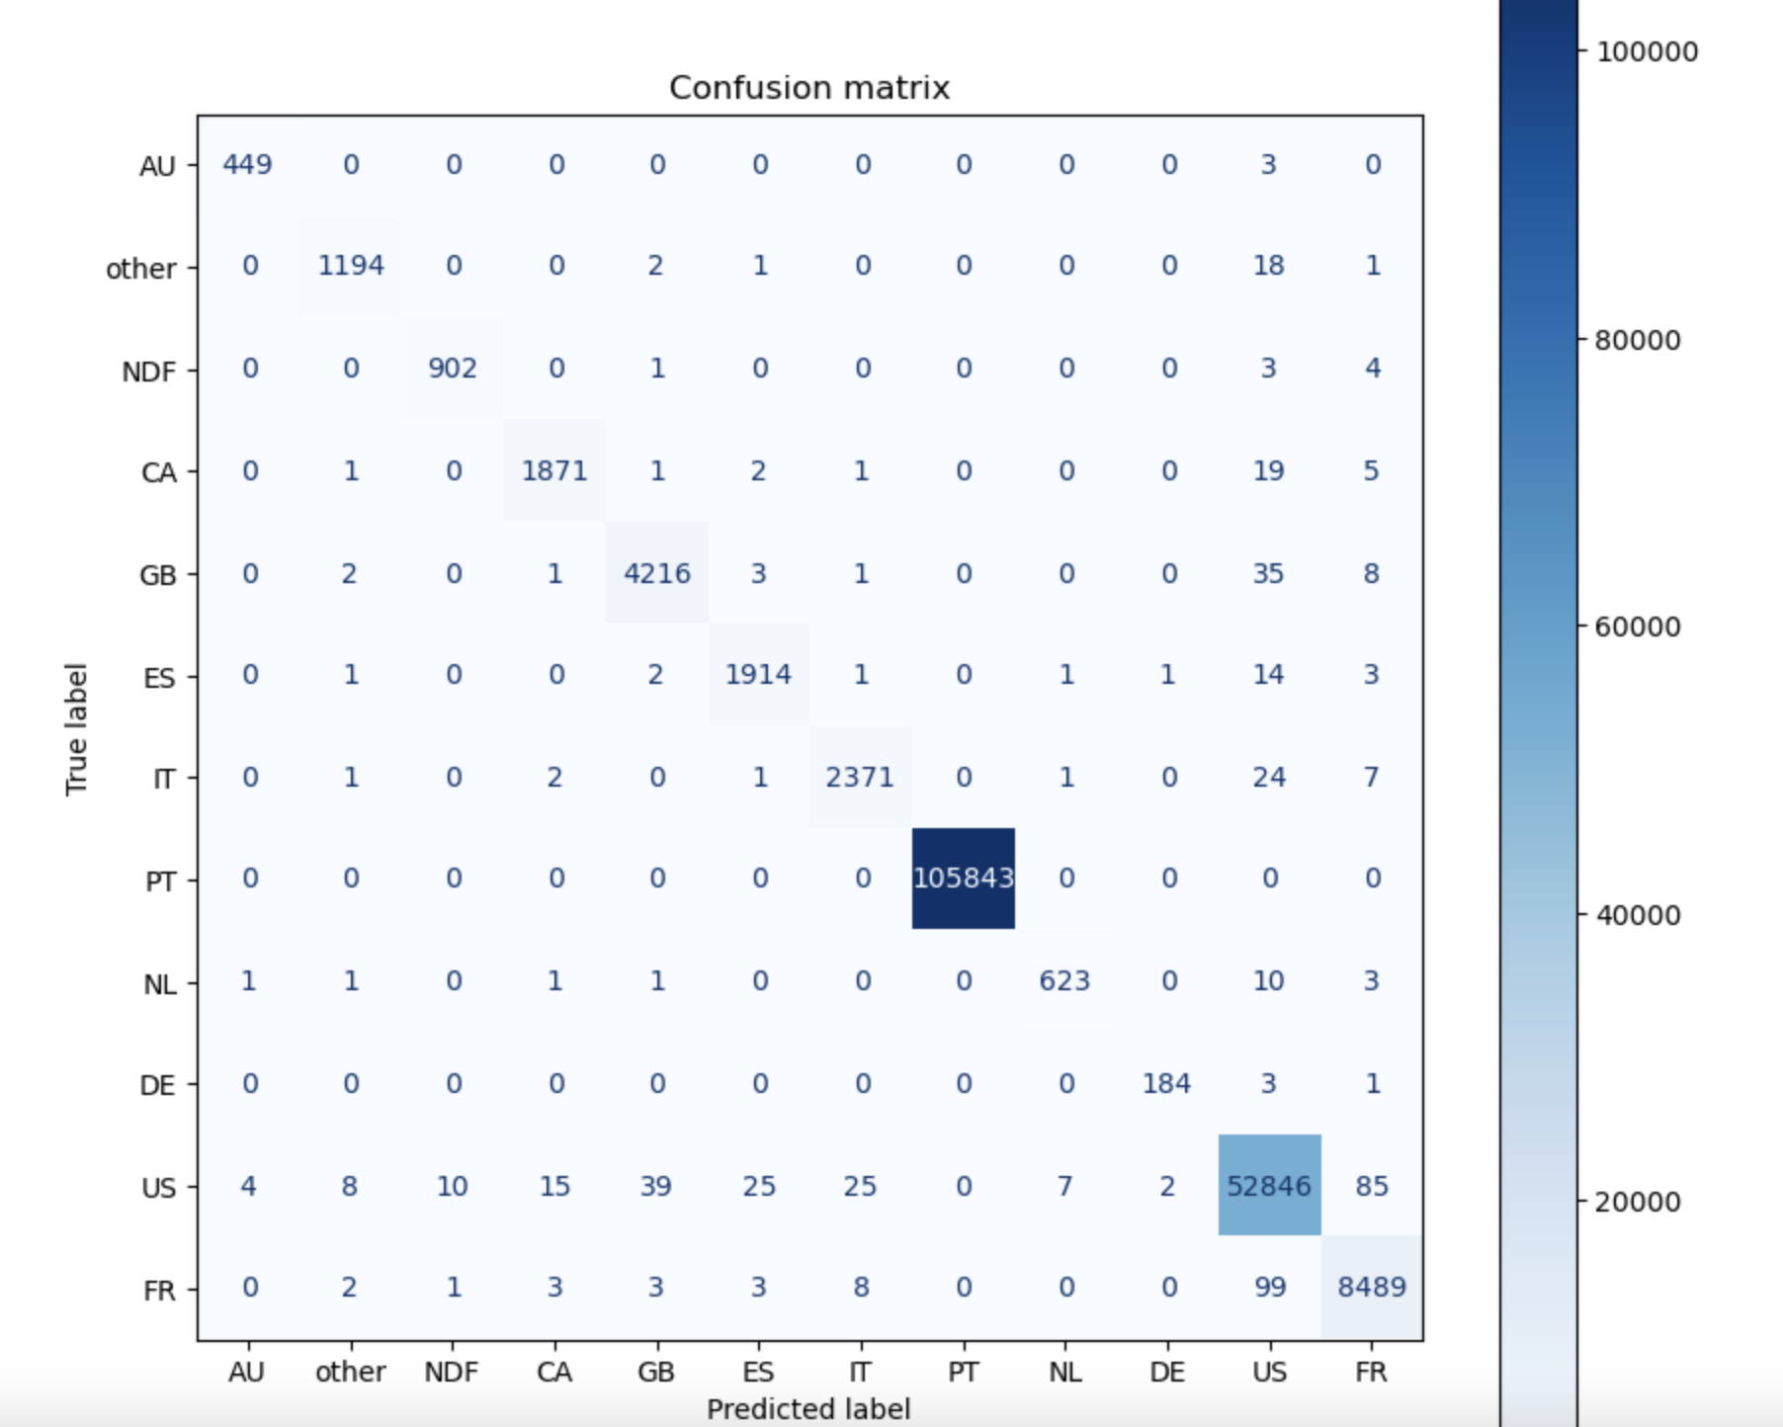
KNN Model Visualization

Slide 15
Evaluation
0.997
Accuracy score

Slide 16

Sustainability
External factors
Internal factors

Slide 17
What’s in it for me?
AIRBNB STAKEHOLDER
1
3
INVESTOR
Business Profit
Real Estate Profit
CUSTOMER
2
4
HOST
Great Recommendation
Better Performance

Slide 18
Next Steps
PROOF OF CONCEPT
Created within this project
CONSTANT UPDATES
Required for the future
MAINTENANCE
Created support channel

